Slide 1

Used Cars Price Prediction An Avalon’s team project
SUBMITTED TO
Dr. Geoffrey Thomas

Slide 2
Outline
Introduction
Data cleaning
Data Visualization
Regression Diagnostic Test
Test of Multicollinearity
Test of Autocorrelation
Test of Homoscedasticity
GitHub Repository

Slide 3
Team Members
Samba Chennamsetty – Team Head
Arif Pasha Shaik – Team Member
Jagadishwar Reddy Velma – Team Member

Slide 4
Introduction
In this project we will explore the data set of Car Dekho. The data set is about secondhand cars and various features of the Cars.
The project will contain an Exploratory Data analysis, a Regression Model and Finally a Simple Supervised Machine Learning Model.

Slide 5
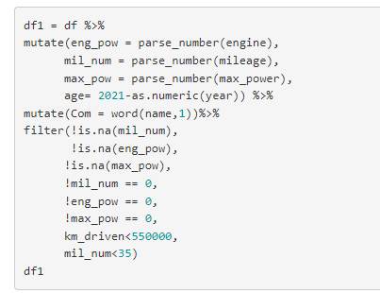
Data Cleaning
In this section using various function of tidyverse package we have cleaned the data. Numbers are extracted detaching them from their unit and also outliers are filtered.
Using the parse_number function the numbers has been detached and with the use of mutate the parsed number is stored in a separate column. filter function is used to get rid of NULL values, 0 values and some outliers.
The logical operators used in filter is according to the need of the data.

Slide 6
Data Visualization
Based on the summary we will be doing the Exploratory Data Analysis (EDA) and will make some insight about the data.
Type of fuel affects the milage and Maximum Power of the Cars
Variation in selling price according to the fuel type of the cars.
Distribution of Cars along with selling price considering owner as a factor.
Distribution of Cars over age of it.

Slide 7
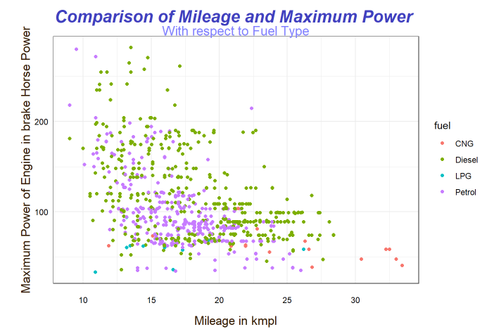
Comparison of mileage and maximum power With fuel type
In this graph, we have a scatter plot where Mileage is on the x-axis and Engine power is on the y axis.
Then the points have been classified based on the fuel type of the cars.
A cluster of petrol cars is found in the 15 to 20 kmpl mileage, whereas no such cluster is found for diesel cars.
LPG cars are of low Mileage and low Engine power, and in contrast to that, cars having CNG as fuel are of excellent efficiency.
Cars with CNG have the highest Mileage.
LPG found to be a more inefficient mode of fuel, but it could be cost-effective in real life, which is the limitation of the data.

Slide 8
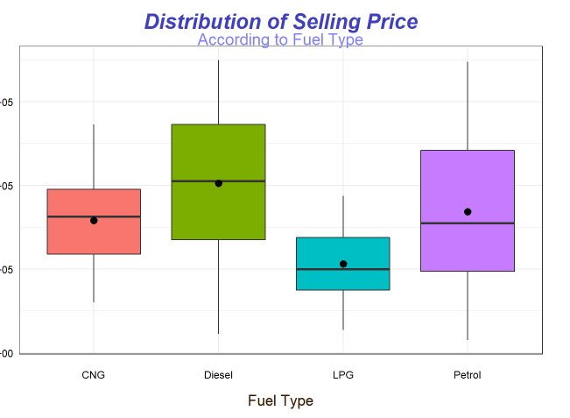
Distribution of selling cars Based of fuel type
Here in the diagram, we can we have the Box plot of the distribution of selling price along with Fuel Type.
As we all know the lower horizontal side of the box tells us about first quartile and the upper side shows third quartile.
The line in between shows the median of the distribution. Along with that using stat summary, the mean value of each class are plotted as a point.
From the distribution it is clear that the on an average the selling price of LPG car is the lowest, whereas the Concentration of Diesel car is at higher selling price section.

Slide 9
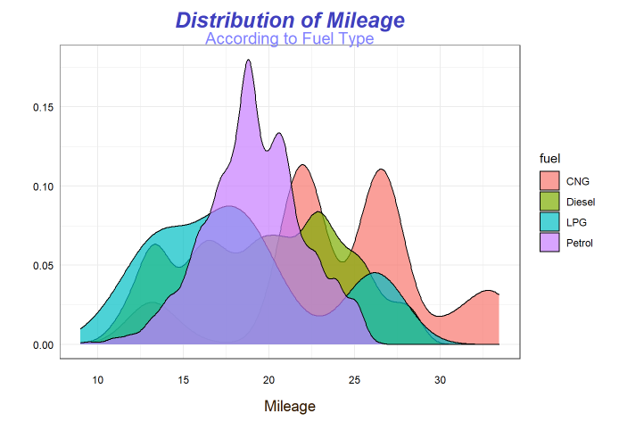
Distribution of mileage based on fuel type
For Petrol cars we can observe that the mean value of the cars is higher than the middle most value.
We can say that the distribution is positively skewed which means there are a smaller number of cars with very high selling price.
For Diesel car the distribution is almost symmetric.

Slide 10
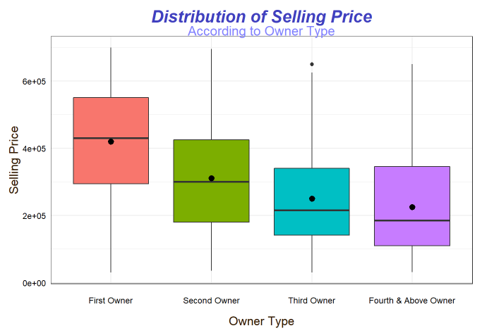
Distribution of selling price according to owner type
This diagram shows the distribution of selling price depending upon the fuel type of the cars.
This diagram shows the reality that New cars have higher selling price. But apart from that one interesting point to note here is that with increasing number of owners the distribution of cars according to selling price changed its skewness.
From slightly negative skewness in First Owner, the skewness became gradually positive, and it is the highest for Fourth and above owner.
In simple words with increasing number of owners Costly cars became less in the market, which shows the main concept that with increasing number of Owner price decreases.

Slide 11
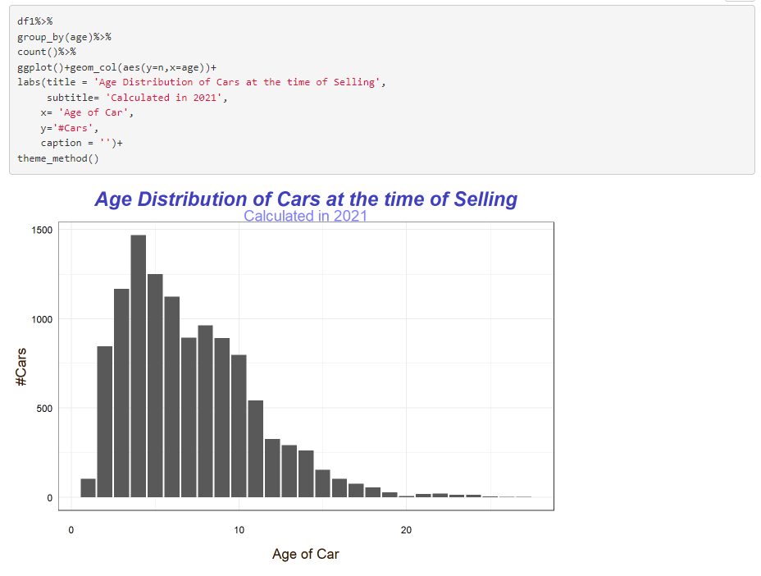
Distribution of selling price according to owner type
Histogram Depicting the Distribution of Cars over age of it.

Slide 12
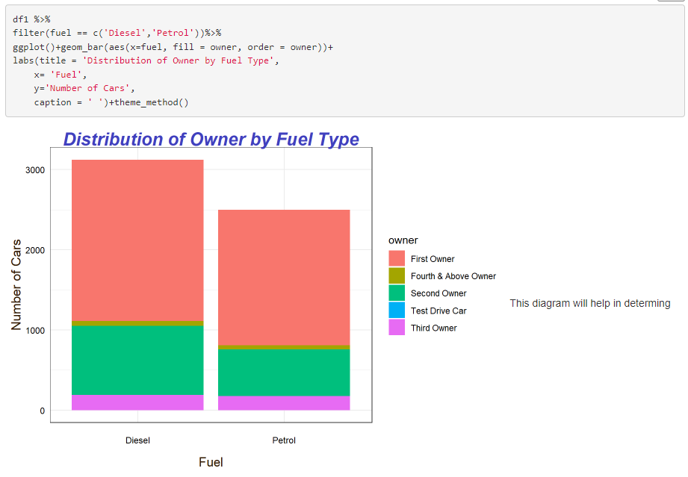
Distribution of selling price according to owner type
This bar diagram will show the distribution of Nature of Ownership based on Fuel Type

Slide 13
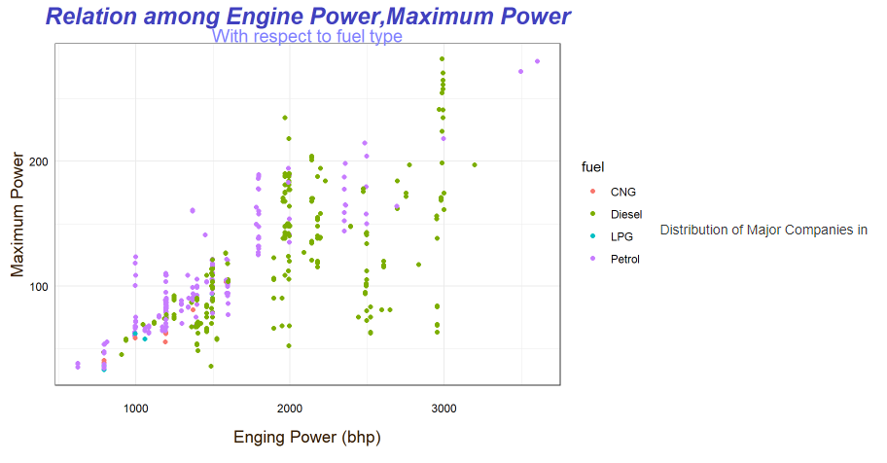
Distribution of selling price according to owner type
Histogram Depicting the Distribution of Cars over age of it.

Slide 14
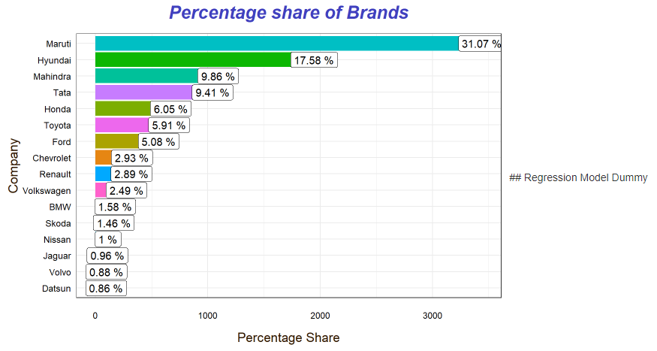
Distribution of selling price according to owner type
Secondhand Market shares of the car companies.

Slide 15
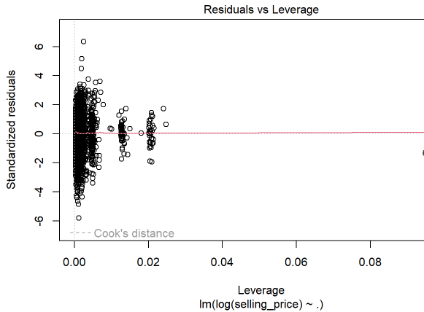
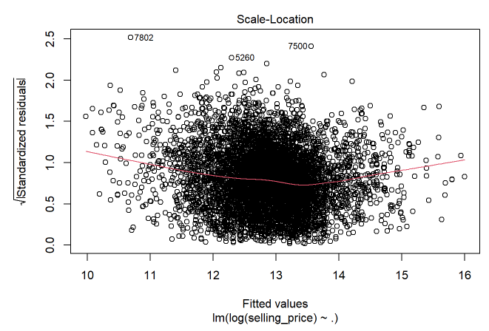
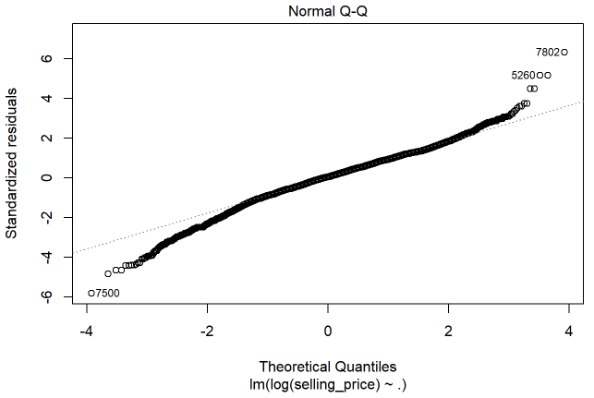
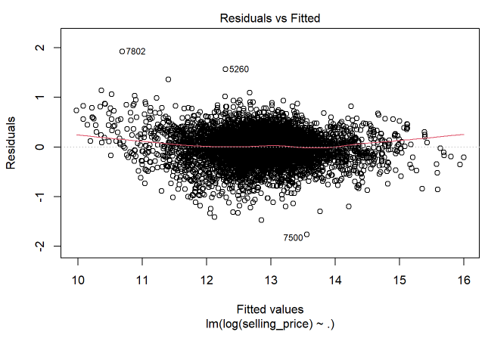
Regression Diagnostic Test
The red lines in the first and fourth diagram should have been parallel to x axis. So, these two results are acceptable.
For ideal regression the points should lie on the diagonal line, our result is also not that bad to reject the model.

Slide 16
GitHub repository
https://github.com/samba-chennamsetty/used-cars-price-prediction-bigdata

Slide 17

Any questions ?

Slide 18
Thank you…!

